Slide 1
Final Year Project: Week 8 of 20
Marij Qureshi 16th Jan 2020
Robust Optimisation of Composite Panels

Slide 2
Fixed model
Re-built from scratch
Changed dimensions to mm, kN, GPa
Fixed overlap of composite plies at joint
Fixed application of load to reference point

Slide 3
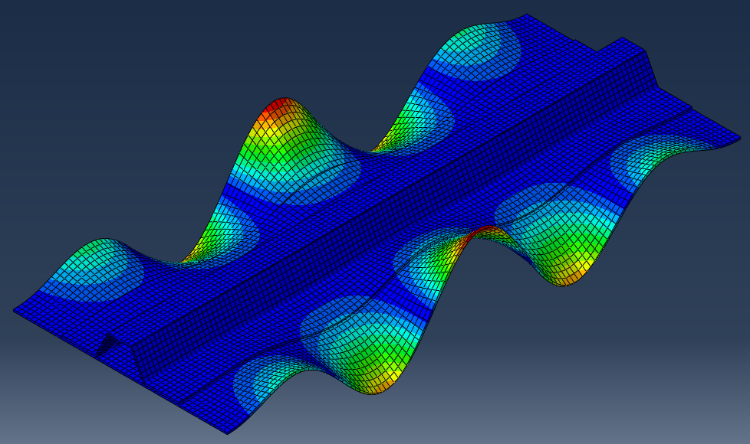
Fixed model
1
1st Eigenvalue
51.301 kN
Alex (Continuum Shell)
53.812 kN

Slide 4
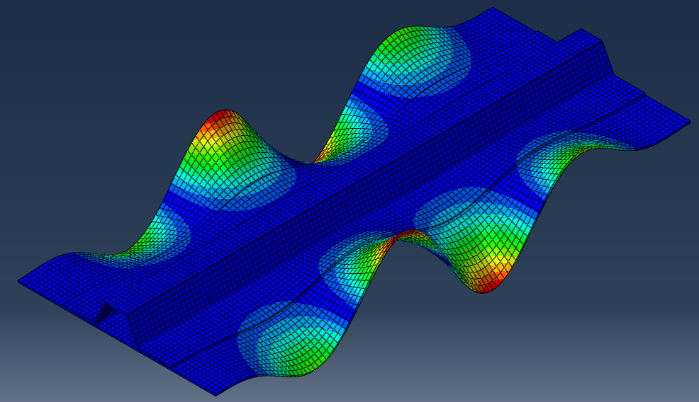
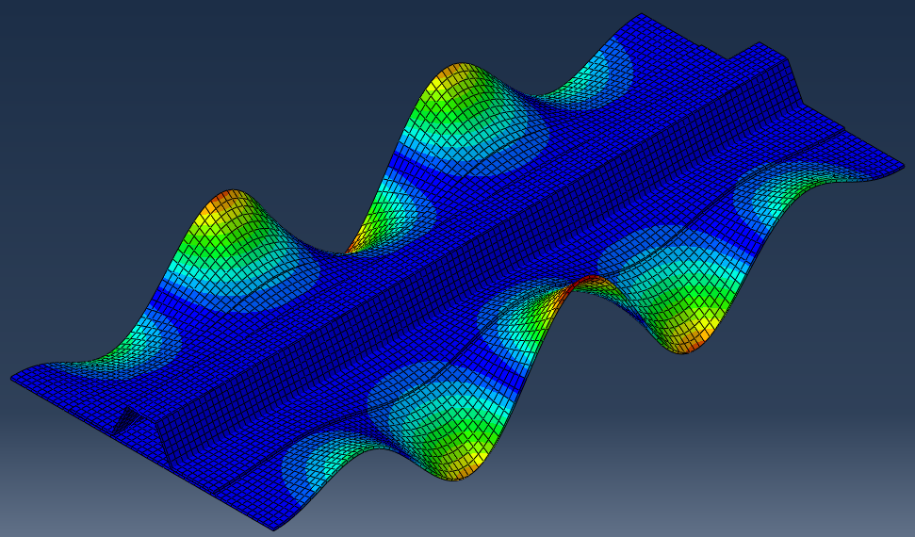
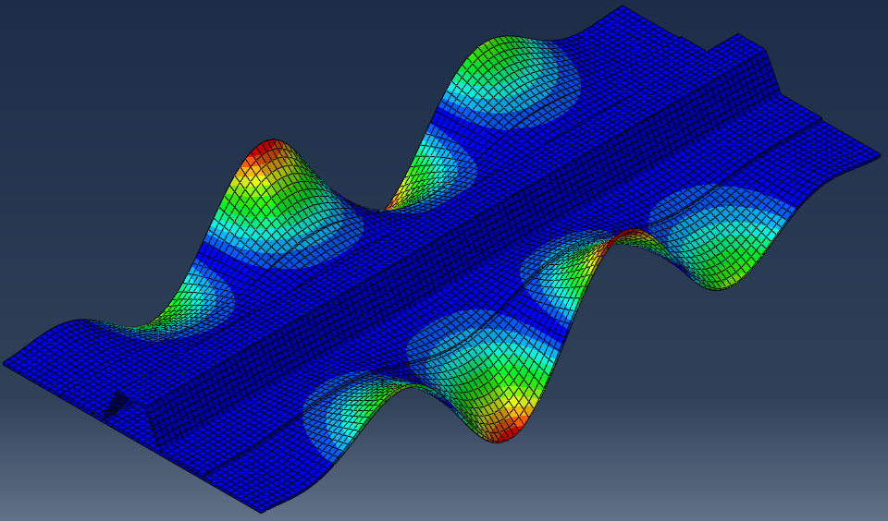
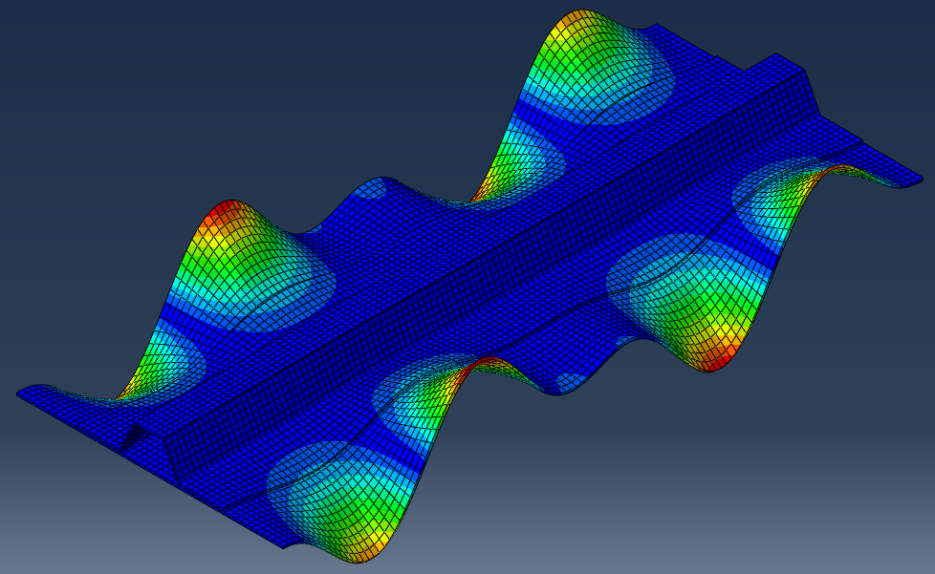
Problem 1: Anti-symmetric higher eigen-modes
2
3
4
5

Slide 5
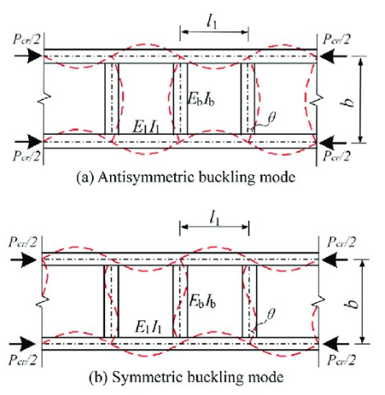
Problem 1: Anti-symmetric higher eigen-modes
Paper by Guo, Zhang, Zhu
Check higher modes against Alex’s continuum shell model

Slide 6
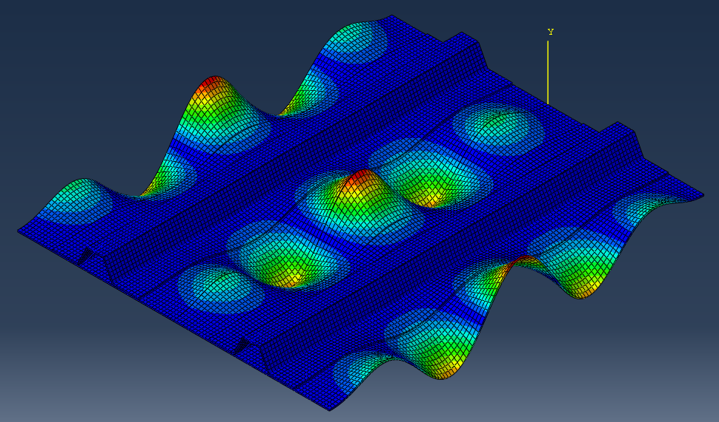
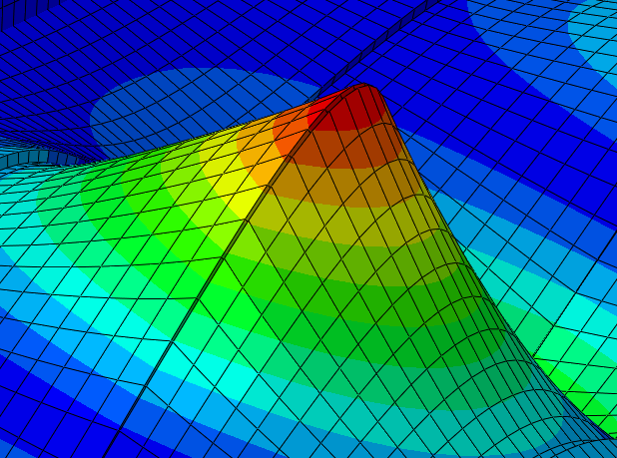
Problem 2: Boundary conditions
1st Eigenvalue
51.301 kN

Slide 7
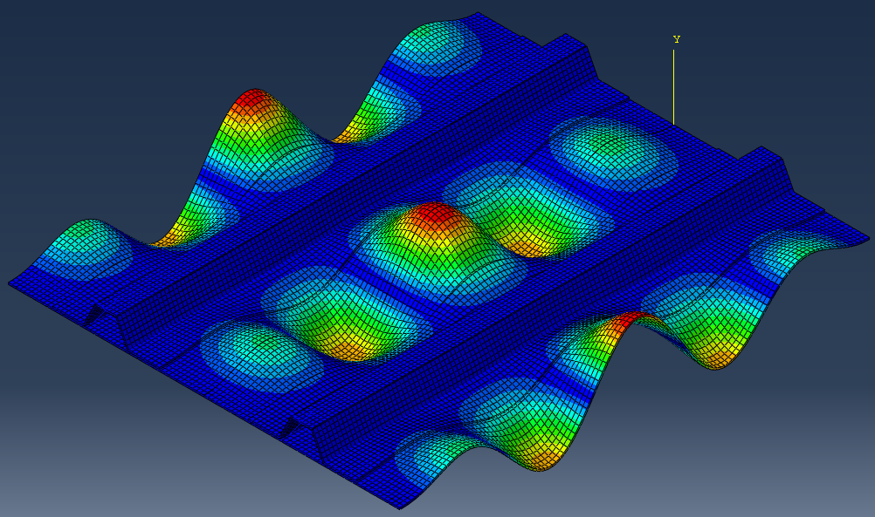
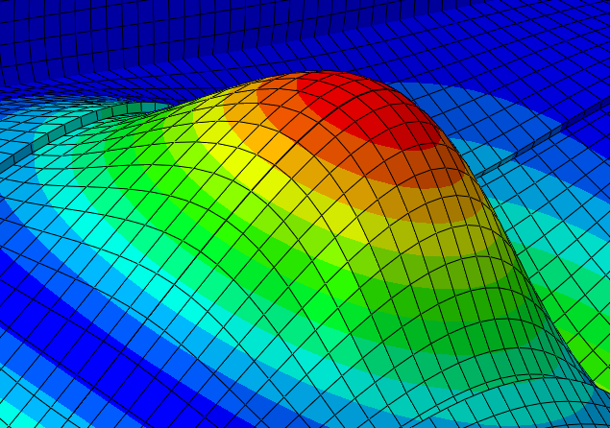
Problem 2: Boundary conditions
1st Eigenvalue
60.803 kN
(Ux = Mz = 0)

Slide 8
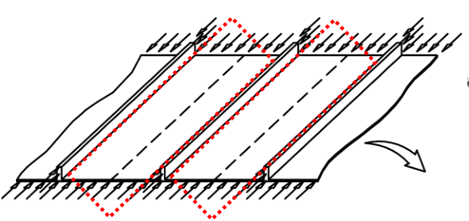

Analytical Validation (Plate Theory)
Skin: $P_{crit}≈4.2E{\left(\frac{t}{b}\right)}^{2}=25.137 kN$
Stiffener: $P_{crit}≈0.6E{\left(\frac{t}{b}\right)}^{2}=29.925 kN$
FEA: $51.301 kN$

Slide 9
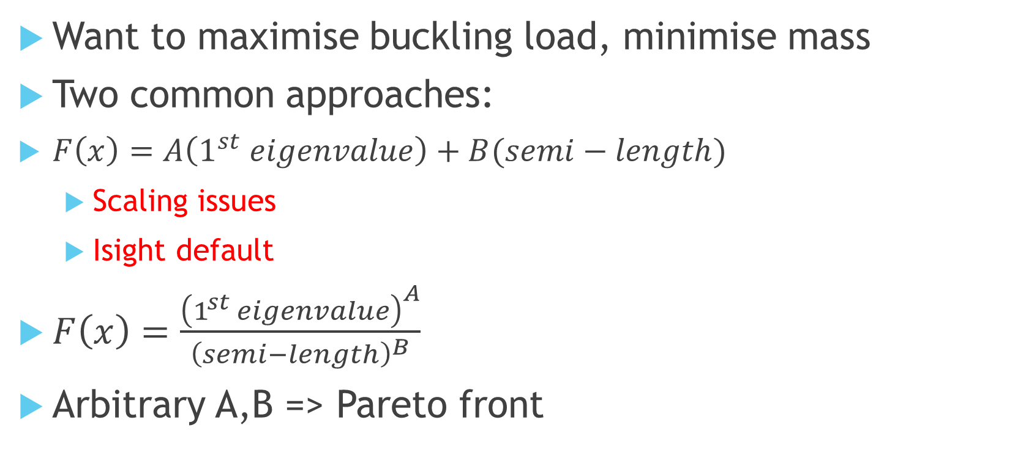
Optimisation Objective Function
Want to maximise buckling load, minimise mass
Two common approaches:
$F\left(x\right)=A\left(1^{st} eigenvalue\right)+B(semi−length)$
$\text{Scaling} \text{issues}$
Isight default
$F\left(x\right)=\frac{{\left(1^{st} eigenvalue\right)}^{A}}{{\left(semi−length\right)}^{B}}$
Arbitrary A,B => Pareto front

Slide 10
Final Report
Initial structure for report
How it all fits together
Started writing introduction
Started drafting analysis + conclusions in relevant sections
Aim to be working from a draft in final 3 weeks, not from nothing
Introduction
Motivation, Literature Review
Fundamentals of optimisation + statistics
Deterministic vs Robust optimisation
Methodology
Results
Validation
Optimisation Algorithm Comparison
Methodology
Performance
Conclusions

Slide 11
Progress
Case 1: Plate with hole
Case 2: Deterministic mono-string
Case 3: Robust mono-string
Main Objectives
Final Report Work
Workflow set-up and learning
Program efficiency + validation
Results validation + analysis
Auxiliary Objectives
Wks 17-19
Wks 1-3
Wks 4-9
Wks 10-15
Week | 1 | 2 | 3 | 4 | 5 | 6 | 7 | 8 | 9 | 10 | 11 | 12 | 13 | 14 | 15 | 16 | 17 | 18 | 19
Month | Jan |  | Feb |  |  |  | Mar |  |  |  |  | Apr |  |  |  | May

Slide 12
Next Steps
Simulation Validation
Analytical Plate Theory
Continuum Shell
Step-loaded buckling
Move on to lay-up deterministic optimisation
…
Objective Case 3: Robust optimisation
Reminder: Interim Feedback Form

Slide 13
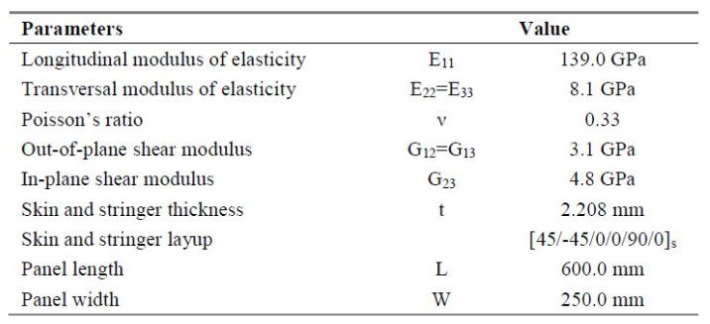
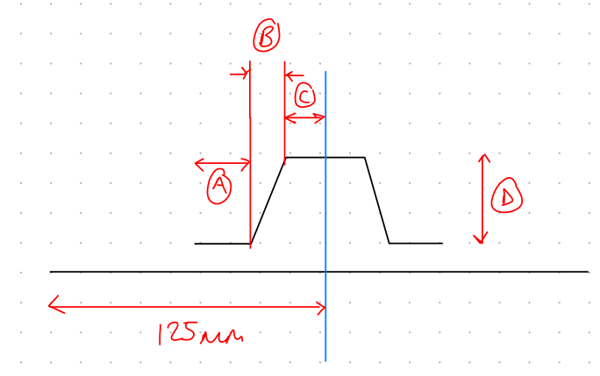
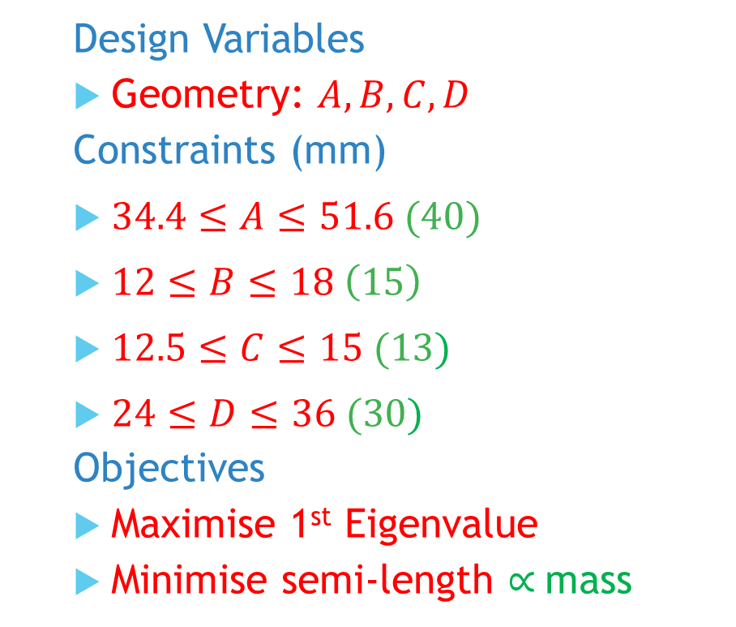
Mono-string: Problem
Design Variables
Geometry: $A,B,C,D$
Constraints (mm)
$34.4≤A≤51.6 (40)$
$12≤B≤18 \left(15\right)$
$12.5≤C≤15 (13)$
$24≤D≤36 (30)$
Objectives
Maximise 1st Eigenvalue
Minimise semi-length $∝$mass
Notes:
Post-buckling reliability design (vary lay-up)
Chapter 7: Robust Multilevel Design Optimization of Composite Panels
Robust and Reliability-Based Design Optimization of a Composite Floor Beam

Slide 14
Interim Feedback
Good overview of project objectives, progress and future plans
More detailed description of robust optimisation problem definition would have been useful
Would have been good to show objective function equation + others
Make sure to check validity of abaqus/Isight results once completed (not blackbox)
Show why conjugate gradient methods work best for certain cases (using maths)
Don’t go into postbuckling behaviour
Don’t study too many optimisation algorithms – focus on 5

